Slide 1
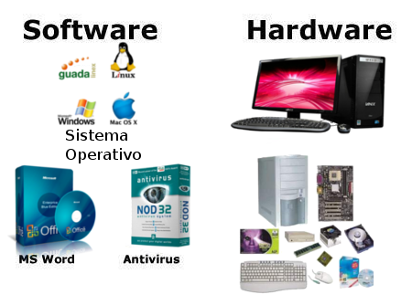
CSE101 Intro to CS and Programming
Hardware and Software
Lecture 5 (Week 3)
By Mr. Faheem Shaukat
faheem@iqraisb.edu.pk
www.tinyurl.com/IUICLectures

Slide 2
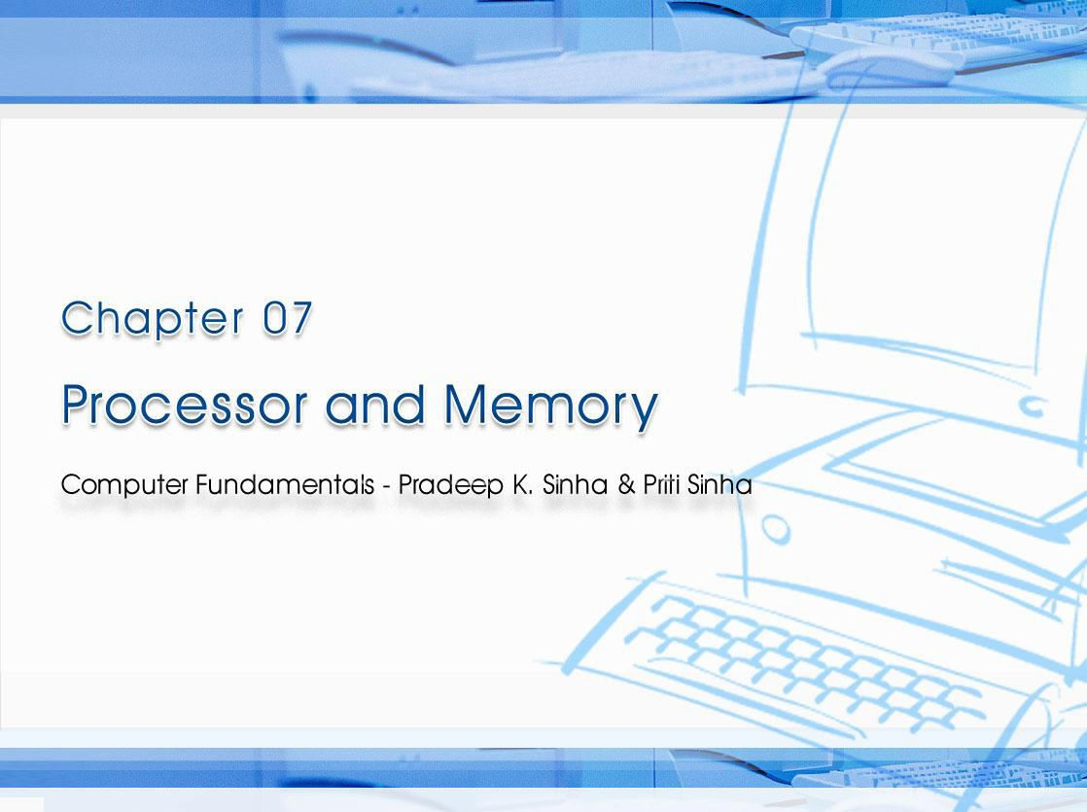
CCoommppuutterer FFununddaammenenttaallss:: PPrradadeeeepp KK.. SSiinhnhaa && PPrriititi SSiinhanha
Ref Page Chapter 7: Processor and Memory Slide 1/27

Slide 3

Computer Fundamentals: Pradeep K. Sinha & Priti Sinha
Learning Obj ect ives
I n this chapter you w ill learn about:
§ Internal structure of processor
§ Memory structure
§ Determining the capacity of a memory
§ Different types of memory available
101
Slide 2/27

Slide 4
Computer Fundamentals: Pradeep K. Sinha & Priti Sinha
Cent ral Processing Unit ( CPU)
§ The brain of a computer system
§ Performs all major calculations and comparisons
§ Activates and controls the operations of other units of a computer system
§ Two basic components are
§ Control Unit (CU)
§ Arithmetic Logic Unit (ALU)
§ No other single component of a computer determines its overall performance as much as the CPU
101
Slide 4/27

Slide 5
Computer Fundamentals: Pradeep K. Sinha & Priti Sinha
Cont rol Unit ( CU)
§ One of the two basic components of CPU
§ Acts
as the central nervous system of
a computer
system
§ Selects
and interprets program instructions, and
coordinates execution
§ Has some special purpose registers and a decoder to perform these activities
101
Slide 5/27

Slide 6
Computer Fundamentals: Pradeep K. Sinha & Priti Sinha
Ar it hm et ic Logic Unit ( ALU)
§ One of the two basic components of CPU.
§ Actual execution of instructions takes place in ALU
§ Has some special purpose registers
§ Has
necessary circuitry to carry out all the
arithmetic and logic operations included in the CPU instruction set
103
Slide 6/27

Slide 7
Computer Fundamentals: Pradeep K. Sinha & Priti Sinha
I nst ruct ion Set
§ CPU has built-in ability to execute a particular set of machine instructions, called its instruction set
§ Most CPUs have 200 or more instructions (such as add, subtract, compare, etc.) in their instruction set
§ CPUs made by different manufacturers have different instruction sets
§ Manufacturers tend to group their CPUs into “families” having similar instruction sets
§ New CPU whose instruction set includes instruction set of its predecessor CPU is said to be backward compatible with its predecessor
103

Slide 8
Regist ers
Computer Fundamentals: Pradeep K. Sinha & Priti Sinha
§ Special memory
units, called
registers, are
used to
hold information on a temporary basis as the instructions are interpreted and executed by the CPU
§ Registers are part of the CPU (not main memory) of a computer
§ The length of a
register, sometimes called its word
size, equals the number of bits it can store
§ With all other parameters being the same, a CPU with 32-bit registers can process data twice larger than one with 16-bit registers
103

Slide 9
Computer Fundamentals: Pradeep K. Sinha & Priti Sinha
Funct ions of Com m only Used Regist ers
Sr. N o. | N am e of Regist er | Funct ion
1 | Memory Address (MAR) | Holds address of the active memory location
2 | Memory Buffer (MBR) | Holds contents of the accessed (read/written) memory word
3 | Program Control (PC) | Holds address of the next instruction to be executed
4 | Accumulator (A) | Holds data to be operated upon, intermediate results, and the results
5 | Instruction (I) | Holds an instruction while it is being executed
6 | Input/Output (I/O) | Used to communicate with the I/O devices
104

Slide 10
Computer Fundamentals: Pradeep K. Sinha & Priti Sinha
Main Mem ory
§ Every computer has a temporary storage built into the computer hardware
§ It stores instructions and data of a program mainly when the program is being executed by the CPU.
§ This temporary storage is known as main memory, primary storage, or simply memory .
§ Physically, it consists of some chips either on the motherboard or on a small circuit board attached to the motherboard of a computer
§ It has random access property.
§ It is volatile.
108

Slide 11
Computer Fundamentals: Pradeep K. Sinha & Priti Sinha
St orage Evaluat ion Cr it er ia
Property | Prim ary storage | Secondary storage
Storage capacity | Small | Large
Access Time | Fast | Slow
Cost per bit of storage | High | Low
Volatility | Volatile | Non-volatile
Access | Random access | Pseudo- random access or sequential access
108

Slide 12
Computer Fundamentals: Pradeep K. Sinha & Priti Sinha
Main Mem ory Organizat ion
0
1
2
3
4
5
Addresses of a memory
The words of a memory
(total N words)
N-2
N-1
Each word contains the same number of bits = word length
(Continued on next slide)
Bit 1 Bit 2
109

Slide 13
Computer Fundamentals: Pradeep K. Sinha & Priti Sinha
Main Mem ory Organizat ion
( Continued from previous slide..)
§ Machines
having smaller word-length are slower in
operation than machines having larger word-length
§ A write to a memory location is destructive to its previous contents
§ A read from a memory location is non-destructive to its previous contents
110

Slide 14
Computer Fundamentals: Pradeep K. Sinha & Priti Sinha
Fixed W ord- lengt h Mem ory
Word
0501
0502
 |  | B | O | M | B | A | Y
 |  |  | D | E | L | H | I
Address Numbers
0503
1024
§ Storage space is always allocated in multiples of word-length
§ Faster in speed of calculation than variable word-length memory
§ Normally used in large scientific computers for gaining speed of calculation
110

Slide 15
Computer Fundamentals: Pradeep K. Sinha & Priti Sinha
Var iable W ord- lengt h Mem ory
0025
0026
B
0051
D § Each memory location
O
0052 E
character
0027 M
0053
0054
L
§ Slower in speed of calculation than fixed world-length memory
0028
B
H
Address
0029
0030
A
Address
0055
I
Y
§ Used in small business
0056
0031
optimizing the use of storage space
4096
4096
N ot e:
With memory becoming cheaper and larger day-by-day, most modern computers employ fixed-word-length memory organization
110

Slide 16
Computer Fundamentals: Pradeep K. Sinha & Priti Sinha
Mem ory Capacit y
§ Memory capacity of a computer is equal to the number of bytes that can be stored in its primary storage
§ Its units are:
Kilobytes (KB)
: 1024 (2¹⁰) bytes
Megabytes (MB)
: 1,048,576 (2²⁰) bytes
Gigabytes (GB)
: 1,073,741824 (2³⁰) bytes
111

Slide 17
Computer Fundamentals: Pradeep K. Sinha & Priti Sinha
Random Access Mem ory ( RAM)
§ Primary storage of a computer is often referred to as RAM because of its random access capability
§ RAM chips are volatile memory
§ A computer’s motherboard is designed in a manner that the memory capacity can be enhanced by adding more memory chips
§ The additional RAM chips, which plug into special sockets on the motherboard, are known as single- in- line m emory modules ( SIMMs)
112

Slide 18
Computer Fundamentals: Pradeep K. Sinha & Priti Sinha
Read Only Mem ory ( ROM)
§ ROM a non-volatile memory chip
§ Data stored in a ROM can only be read and used – they cannot be changed
§ ROMs are mainly used to store programs and data, which do not change and are frequently used. For example, system boot program
112

Slide 19
Computer Fundamentals: Pradeep K. Sinha & Priti Sinha
Types of ROMs
Type | Usage
Manufacturer-programmed ROM | Data is burnt by the manufacturer of the electronic equipment in which it is used.
User-programmed ROM or Programmable ROM (PROM) | The user can load and store “read-only” programs and data in it
Erasable PROM (EPROM) | The user can erase information stored in it and the chip can be reprogrammed to store new information
(Continued on next slide)
112

Slide 20
Computer Fundamentals: Pradeep K. Sinha & Priti Sinha
Types of ROMs
( Continued from previous slide..)
Type | Usage
Ultra Violet EPROM (UVEPROM) | A type of EPROM chip in which the stored information is erased by exposing the chip for some time to ultra-violet light
Electrically EPROM (EEPROM) or Flash memory | A type of EPROM chip in which the stored information is erased by using high voltage electric pulses
113

Slide 21
Computer Fundamentals: Pradeep K. Sinha & Priti Sinha
Cache Mem ory
§ It is commonly used for minimizing the memory- processor speed mismatch.
§ It is an extremely fast, small memory between CPU and main memory whose access time is closer to the processing speed of the CPU.
§ It is used to temporarily store very active data and instructions during processing.
Cache is pronounced as “ cash”
113

Slide 22
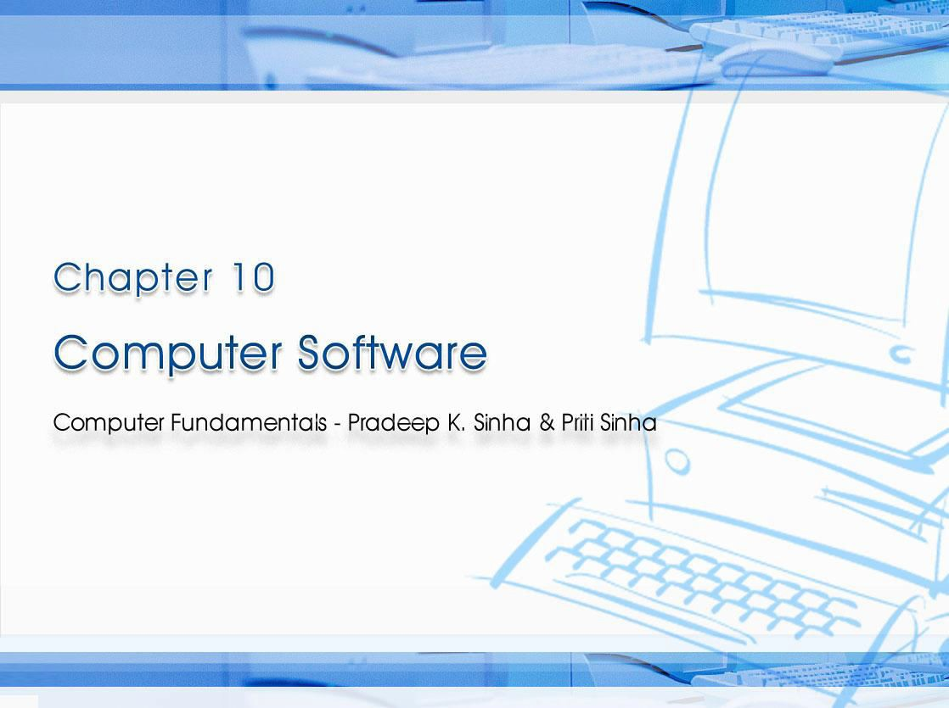
CCoommppuutterer FFununddaammenenttaallss:: PPrradadeeeepp KK.. SSiinhnhaa && PPrriititi SSiinhanha
Ref Page Chapter 10: Computer Software Slide 1/17

Slide 23
Computer Fundamentals: Pradeep K. Sinha & Priti Sinha
Learning Obj ect ives
I n this chapter you w ill learn about:
§ Term “Software” and its relationship with “Hardware”
§ Various types of software and their examples
§ Relationship among hardware, system software, application software, and users of a computer system
§ Various steps involved in software development
§ Firmware
§ Middleware
172

Slide 24
Soft w are
Computer Fundamentals: Pradeep K. Sinha & Priti Sinha
§ Hardw are refers to the physical devices of a computer system.
§ Softw are refers to a collection of programs
§ Program is a sequence of instructions written in a language that can be understood by a computer
§ Softw are package is a group of programs that solve a specific problem or perform a specific type of job
172

Slide 25
Computer Fundamentals: Pradeep K. Sinha & Priti Sinha
Relat ionship Bet w een Hardw are and Soft w are
§ Both hardware and software are necessary for a computer to do useful job. They are complementary to each other
§ Same hardware can be loaded with different software to make a computer system perform different types of jobs
§ Except for upgrades, hardware is normally a one- time expense, whereas software is a continuing expense
§ Upgrades refer to renewing or changing components like increasing the main memory, or hard disk capacities, or adding speakers, modems, etc.
173

Slide 26
Computer Fundamentals: Pradeep K. Sinha & Priti Sinha
Types of Soft w are
Most software can be divided into two major categories:
§ System softw are are designed to control the operation and extend the processing capability of a computer system
§ Application softw are are designed to solve a specific problem or to do a specific task
173

Slide 27
Computer Fundamentals: Pradeep K. Sinha & Priti Sinha
Syst em Soft w are
§ Make the operation of a computer system more effective and efficient
§ Help hardware components work together and provide support for the development and execution of application software
§ Programs included in a system software package are called system program s and programmers who prepare them are called system program m ers
§ Examples of system software are operating systems, programming language translators, utility programs, and communications software
173

Slide 28
Computer Fundamentals: Pradeep K. Sinha & Priti Sinha
Applicat ion Soft w are
§ Solve a specific problem or do a specific task
§ Programs included in an application software package are called application program s and the programmers who prepare them are called
application program m ers
§ Examples of application software are word processing, inventory management, preparation of tax returns, banking, etc.
174

Slide 29
Computer Fundamentals: Pradeep K. Sinha & Priti Sinha
W ays of Acquir ing Soft w are
§ Buying pre-written software
§ Ordering
customized software
§ Developing customized software
§ Downloading public-domain software
Each of these ways of acquiring software has its own advantages and limitations
176

Slide 30
Computer Fundamentals: Pradeep K. Sinha & Priti Sinha
Soft w are Developm ent St eps
Developing a software and putting it to use is a complex process and involves following steps:
§ Analyzing the problem at hand and planning the program(s) to solve the problem
§ Coding the program(s)
§ Testing, debugging, and documenting the program(s)
§ Implementing the program(s)
§ Evaluating and maintaining the program(s)
178

Slide 31
Firm w are
Computer Fundamentals: Pradeep K. Sinha & Priti Sinha
§ Firmware is software substituted for hardware and stored in read-only memory
§ Firmware technology has enabled production of various types of smart machines having microprocessor chips with embedded software
179

Slide 32
Middlew are
Computer Fundamentals: Pradeep K. Sinha & Priti Sinha
§ Basic idea is to have a separate software layer to:
§ Act as “glue” between client and server parts of application
§ Provide programming abstraction
§ Mask heterogeneity of underlying network, hardware, and OS
§ Encourages three- t ier software architecture against two- tier popularized by Server-Client architecture
179

